Slide 1

Why Read the Classics
David M. Jared, P.E.
NAS Toastmasters Club
12 December 2024
Notes:
Let me begin by stating who this talk is for:
those who read or have read the classics (my choir);
those who read but not the classics; and
those who read little or not at all.
In short: everyone! I hope that of you, whatever your reading disposition is, will benefit from this talk.

Slide 2

Talking Points
What is a “classic”?
My classical education
Three great reasons to read the classics

Slide 3
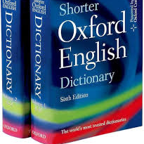
What is a “classic”?
(Shorter) OED: “the body of literature…that is considered excellent, significant, or standard”
Webster: “a work of enduring excellence” (m-w.com)
Jared: works that not only endure, but endure because of their excellence
  Why people still care about Mr. Darcy, a white whale, and a medieval Italian feud

Slide 4
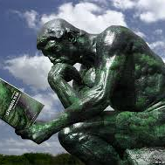
My classical education
Precocious youth and a bookish big sis
Too much time on my hands
Teacher, teacher…and enter big bro
The happiness of pursuit
Second (and third, and fourth) looks

Slide 5
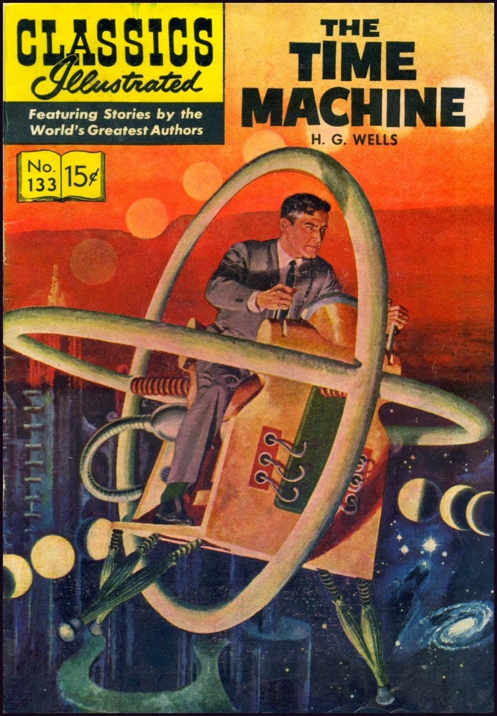
Three great reasons to read the classics
Education
Inspiration
Transportation
This Photo by Unknown Author is licensed under CC BY-NC-ND
Notes:
Education—not complete without some exposure to the classics; hard to understand Western culture without some knowledge of the Bible, Greek and Latin literature, Shakespeare, and the great novels
Inspiration—guarantee you can find something in the classics to inspire you (truck driver, baseball player, or CPA); classics were written by so many types of people, some of whom with backgrounds just like yours, though likely in another historical period
Transportation—cheap time travel; not only looking around at the sights, but learning how people thought, felt, and acted in various times, literally transporting you back there (or forward to possible scenarios, many dystopian)

Slide 6

Thank you!
Notes:
“My father always told me – Never trust anyone whose TV is bigger than their bookshelf.” – Emilia Clarke

